Slide 1
Velké meteoritické impakty
s využitím materiálů V. Procházky
Impaktové struktury: (z angl. Slova „impact“dopad)
geologická struktura vzniklá po dopadu kosmického tělesa, s charakteristickými znaky danými velmi rychlým uvolněním značné kinetické energie
- též „(impaktní) kráter“, ale většina impaktů na Zemi je již morfologicky nevýrazných (zvl. velké a staré)

Slide 2
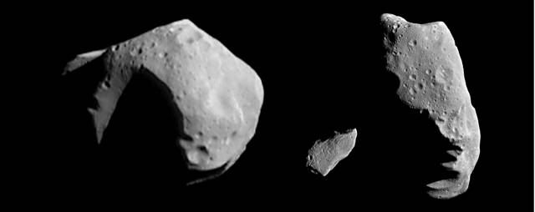
Původ meteroritů, komet, planetek
Souvisí s procesy vzniku sluneční soustavy asi před 4,6 miliardami let
vznik planet - akrece, velmi časté srážky různě velkých částic, bombardování protoplanet, zvěšování jejich, později nárazy do již solidifiovaných planet
planetkami (“bombardování”) asi do 3,8 miliard, pak již impakty řidší

Slide 3
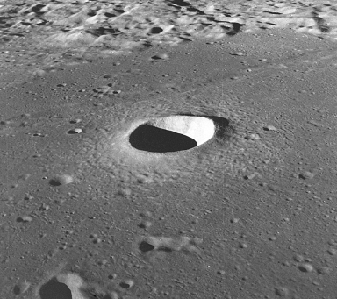
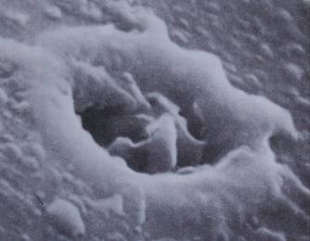
Měsíc
krátery od mikroskopické velikosti
  i malé částice prachu dopadají nebrzděny vzduchem
Měsíční „moře“ – velké impakty ?

Slide 4
Dráhy planetek a meteoritů, srážky se Zemí
tělesa se pohybují přibližně v rovině zemské dráhy
rychlost oběhu: Země 30 km/s, asteroidy (planetky) až 42 km/s
vzájemná rychlost většinou 11-25,
Meteory - vidět jsou i zrnka prachu
atmosféra zbrzdí jen malá tělesa
  (asi do 10-50 m - podle rychlosti, hustoty) ,nedopadají kosmickou rychlostí

Slide 5
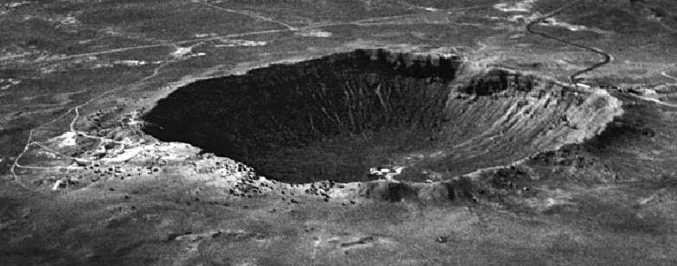
Velká tělesa - dopad kosmickou rychlostí; průměr kráteru ~ 20x průměr tělesa
v moři vznikne na dně kráter jen po dopadu velkého tělesa (> asi 1/10 hloubky)
  vznikají tsunami
  Zemském povrchustaré krátery podléhají rychle erozi,
  v mořích zaneseny sedimenty

Slide 6
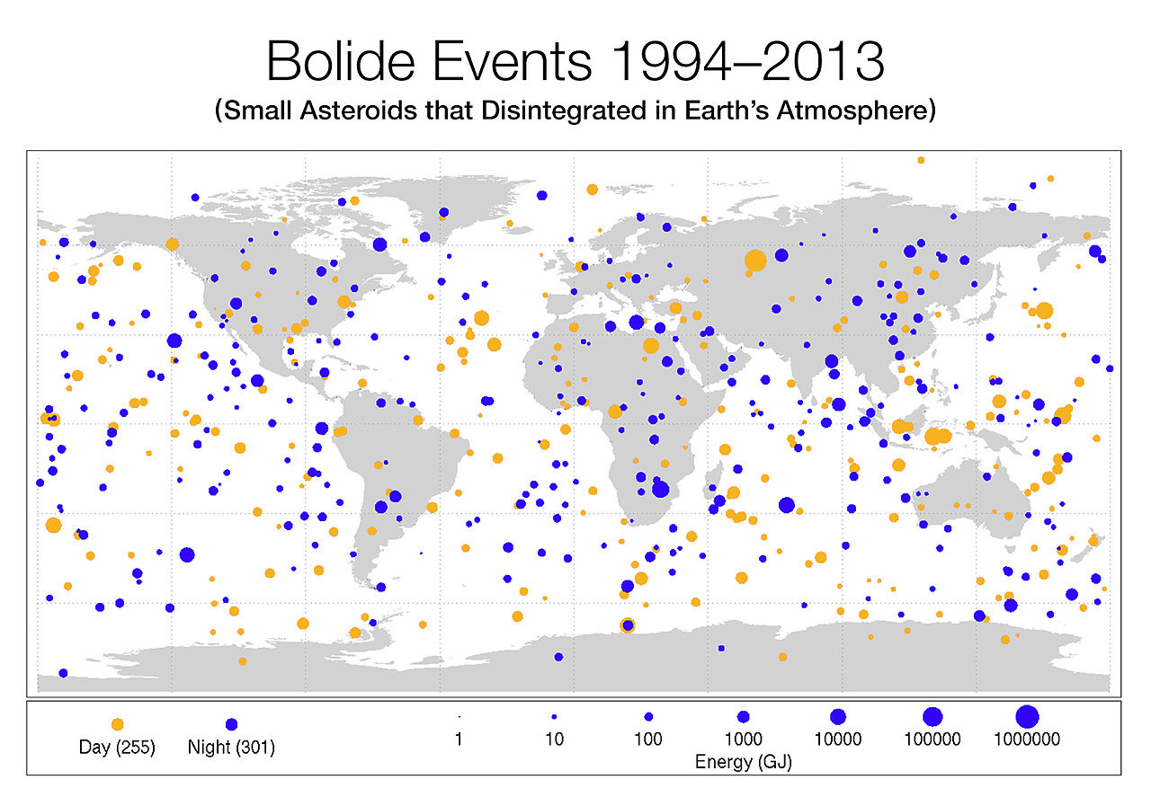

Slide 7
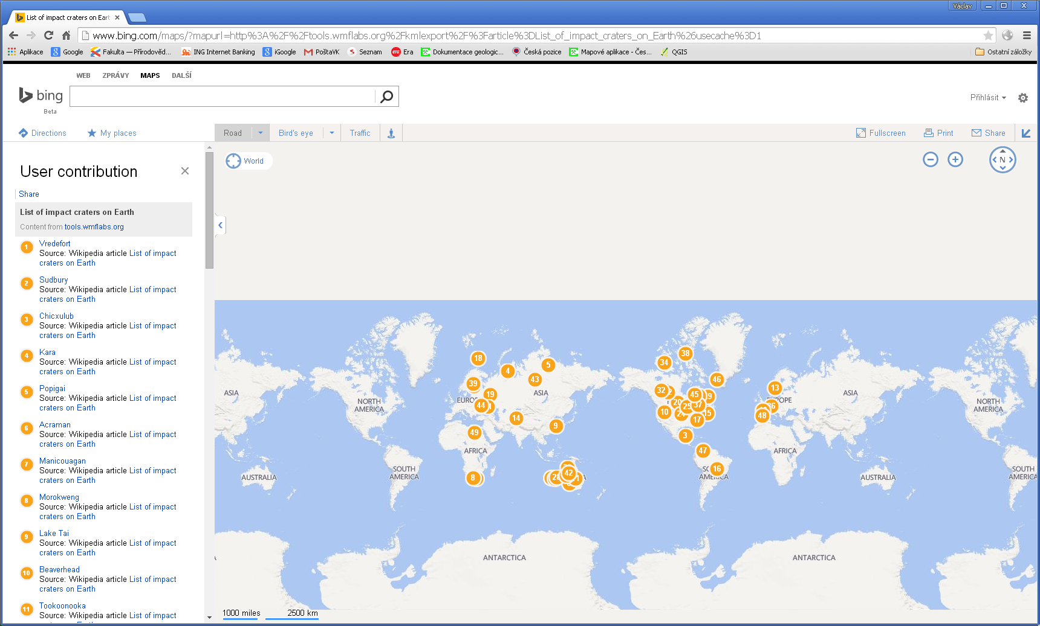
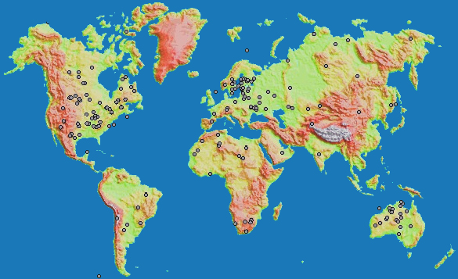
Impaktní krátery na Zemi – s průměrem větším než
20 km

Slide 8
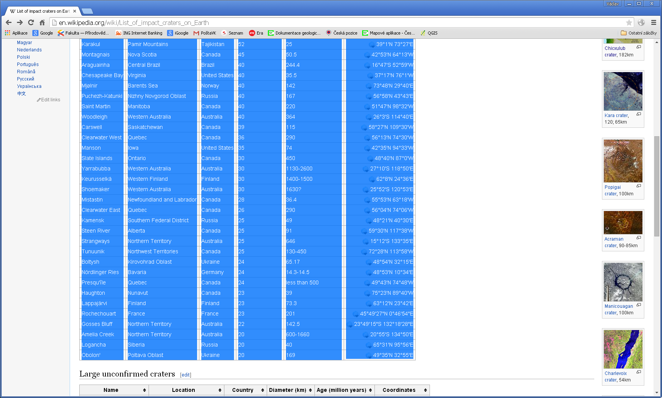

Slide 9
(The tables above use a density of 2600 kg/m³, velocity of 17 km/s, and an angle of 45 degree
tony asteroid impacts that generate an airburst[6]
Impactor diameter | Kinetic energy at atmospheric entry | Airburst energy | Airburst altitude | Average frequency
4 m (13 ft) | 3 kt | 0.75 kt | 42.5 km (139,000 ft) | 1.3 years
7 m (23 ft) | 16 kt | 5 kt | 36.3 km (119,000 ft) | 4.6 years
10 m (33 ft) | 47 kt | 19 kt | 31.9 km (105,000 ft) | 10.4 years
15 m (49 ft) | 159 kt | 82 kt | 26.4 km (87,000 ft) | 27 years
20 m (66 ft) | 376 kt | 230 kt | 22.4 km (73,000 ft) | 60 years
30 m (98 ft) | 1.3 Mt | 930 kt | 16.5 km (54,000 ft) | 185 years
50 m (160 ft) | 5.9 Mt | 5.2 Mt | 8.7 km (29,000 ft) | 764 years
70 m (230 ft) | 16 Mt | 15.2 Mt | 3.6 km (12,000 ft) | 1900 years
85 m (279 ft) | 29 Mt | 28 Mt | 0.58 km (1,900 ft) | 3300 years
Impactor diameter | Kinetic energy at atmospheric entry | Impact energy | Crater diameter | Average frequency
100 m (330 ft) | 47 Mt | 38 Mt | 1.2 km (0.75 mi) | 5200 years
130 m (430 ft) | 103 Mt | 64.8 Mt | 2 km (1.2 mi) | 11000 years
150 m (490 ft) | 159 Mt | 71.5 Mt | 2.4 km (1.5 mi) | 16000 years
200 m (660 ft) | 376 Mt | 261 Mt | 3 km (1.9 mi) | 36000 years
250 m (820 ft) | 734 Mt | 598 Mt | 3.8 km (2.4 mi) | 59000 years
300 m (980 ft) | 1270 Mt | 1110 Mt | 4.6 km (2.9 mi) | 73000 years
400 m (1,300 ft) | 3010 Mt | 2800 Mt | 6 km (3.7 mi) | 100000 years
700 m (2,300 ft) | 16100 Mt | 15700 Mt | 10 km (6.2 mi) | 190000 years
1,000 m (3,300 ft) | 47000 Mt | 46300 Mt | 13.6 km (8.5 mi) | 440000 years

Slide 10
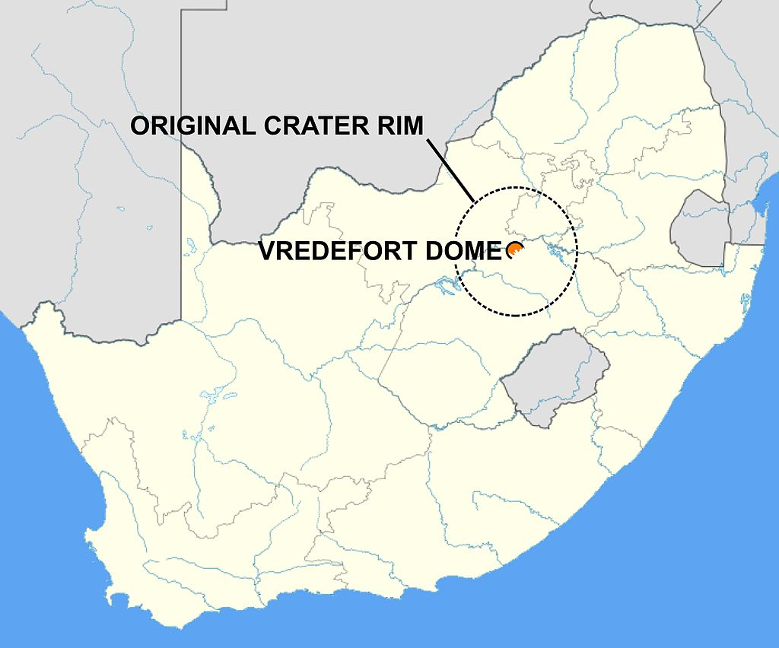
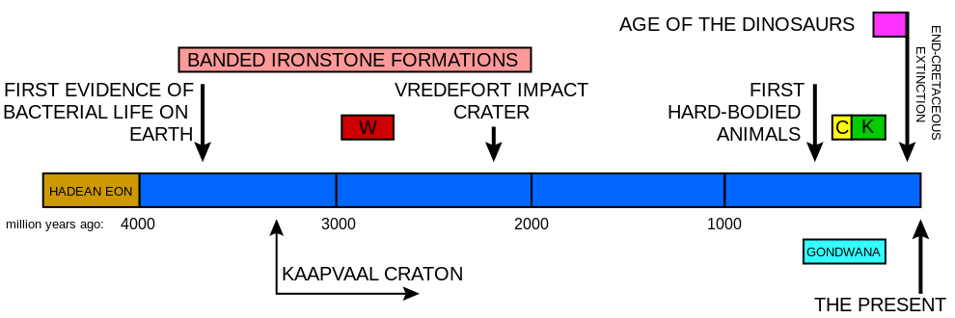
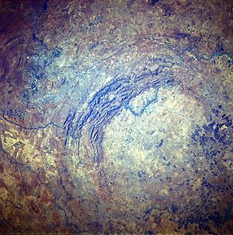
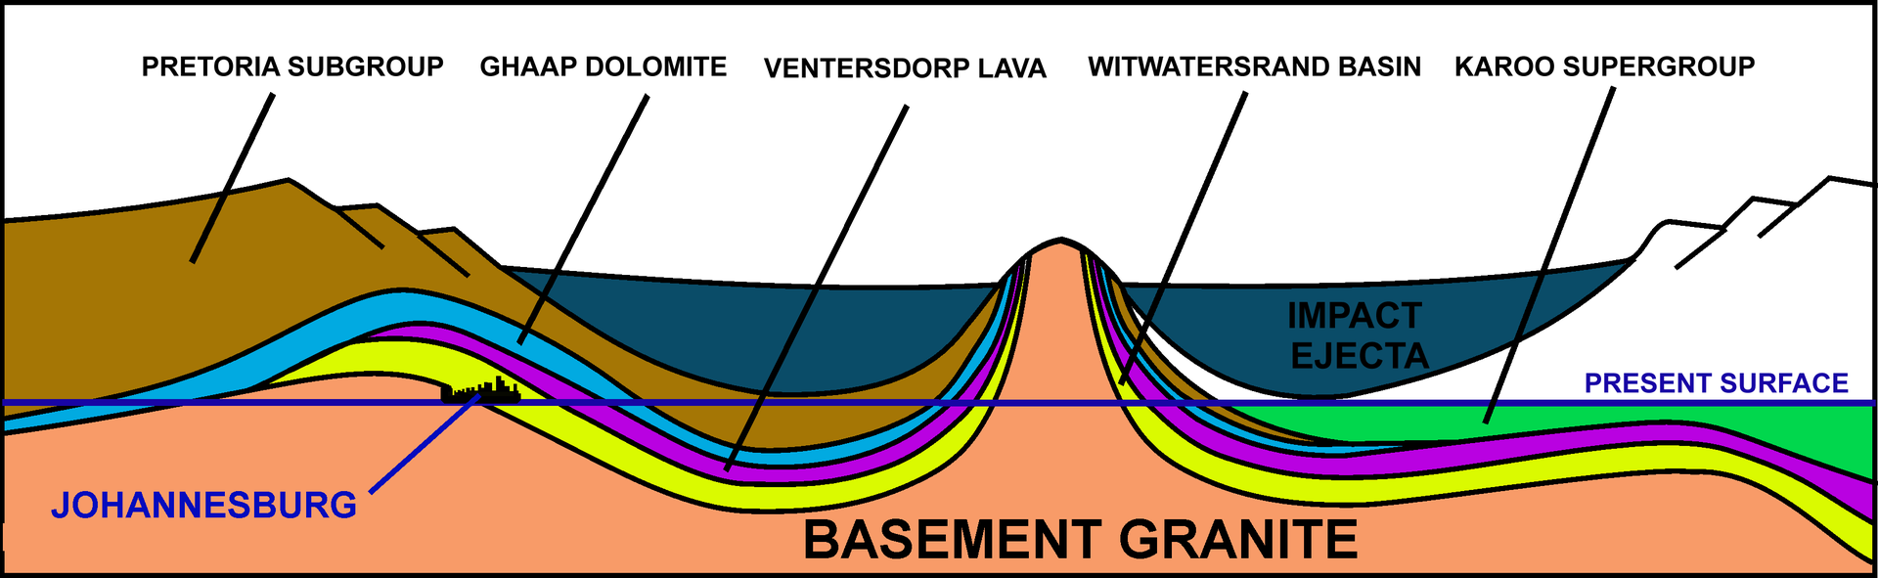
Vredefort Dome
Notes:
The asteroid that hit Vredefort is estimated to have been one of the largest ever to strike Earth (at least since theHadean Eon some four billion years ago), thought to have been approximately 5–10 km (3.1–6.2 mi) in diameter. Thebolide that created the Sudbury Basin could have been even larger.^{[3]}
The original crater was estimated to have a diameter of roughly 300 km (190 mi),^{[2]} although this has been eroded away. It would have been larger than the 250 km (160 mi) Sudbury Basin and the 180 km (110 mi) Chicxulub Crater. The remaining structure, the "Vredefort Dome", consists of a partial ring of hills 70 km in diameter, and are the remains of a dome created by the rebound of rock below the impact site after the collision.
The crater's age is estimated to be 2.023 billion years (± 4 million years),^{[1]} which places it in the Paleoproterozoic Era. It is the second-oldest known crater on Earth, a little less than 300 million years younger than the Suavjärvi Crater in Russia. In comparison, it is about 10% older than the Sudbury Basin impact (at 1.849 billion years).
A timeline of the earth's history indicating when the Vredefort crater was formed in relation to some of the other important South African geological events. W indicates when the Witwatersrand supergroup was laid down, C the Cape supergroup, and K the Karoo Supergroup. The graph also indicates the period during which banded ironstone formations were formed on earth, indicative of an oxygen-free atmosphere. The earth's crust was wholly or partially molten during the Hadean Eon; the oldest rocks on earth are therefore less than 4000 million years old. One of the first microcontinents to form was the Kaapvaal Craton, which is exposed at the center of the Vredefort Dome, and again north of Johannesburg - see the diagram below.
The dome in the center of the crater was originally thought to have been formed by a volcanic explosion, but in the mid-1990s, evidence revealed it was the site of a huge bolide impact, as telltale shatter cones were discovered in the bed of the nearby Vaal River.
The crater site is one of the few multiple-ringed impact craters on Earth, although they are more common elsewhere in the Solar System. Perhaps the best-known example is Valhalla Crater on Jupiter's moon Callisto, although Earth's Moon has a number, as well. Geological processes, such as erosion and plate tectonics, have destroyed most multiple-ring craters on Earth.
A schematic diagram of a NE (left) to SW (right) cross-section through the 2020 million year old Vredefort impact crater and how it distorted the contemporary geological structures. The present erosion level is shown. Johannesburg is located where theWitwatersrand Basin (the yellow layer) is exposed at the "present surface" line, just inside the crater rim, on the left. Not to scale.
The impact distorted the Witwatersrand Basin which was laid down over a period of 250 million years between 950 and 700 million years before the Vredefort impact. The overlying Ventersdorp lavas and the Transvaal Supergroup which were laid down between 700 and 80 million years before the meteorite strike, were similarly distorted by the formation of the 300 km wide crater.^{[4][5]} These rocks form partial concentric rings round the crater center today, with the oldest, the Witwatersrand rocks, forming a semicircle 25 km from the center. Since the Witwatersrand rocks consist of several layers of very hard, erosion resistant sediments (e.g. quartzites and banded ironstones),^{[4][6]} they form the prominent arc of hills that can be seen to the NW of the crater center in the satellite picture above. The Witwatersrand rocks are followed, in succession, by the Ventersdorp lavas at a distance of about 35 km from the center, and the Transvaal Supergroup, consisting of a narrow band of the Ghaap Dolomiterocks and the Pretoria Subgroup of rocks, which together form a 25–30 km wide band beyond that.^{[7]} From about halfway through the Pretoria Subgroup of rocks around the crater center, the order of the rocks is reversed. Moving outwards towards where the crater rim used to be, the Ghaap Dolomite group resurfaces at 60 km from the center, followed by an arc of Ventersdorp lavas, beyond which, at between 80 and 120 km from the center, the Witwatersrand rocks re-emerge to form an interrupted arc of outcrops today, of which the Johannesburg group is the most famous, because it was here that gold was discovered in 1886.^{[4][7]} It is thus possible that if it had not been for the Vredefort impact this gold would never have been discovered.^{[4]}
The 40 km diameter center of the Vredefort crater consists of a granite dome (where it is not covered by much younger rocks belonging to the Karoo Supergroup) which is an exposed part of the Kaapvaal craton, one of the oldest microcontinents which formed on earth 3900 million years ago.^{[4]} This central peak uplift, or dome, is typical of a complex impact crater, where the liquefied rocks splashed up in the wake the meteor as it penetrated the surface.
Conservation[edit]

Slide 11
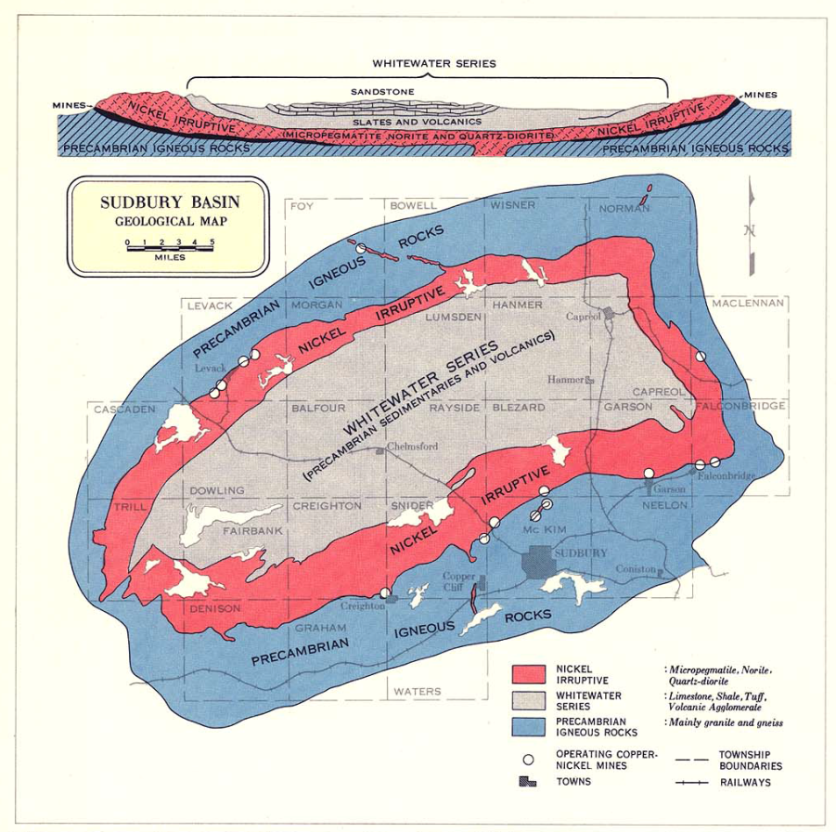
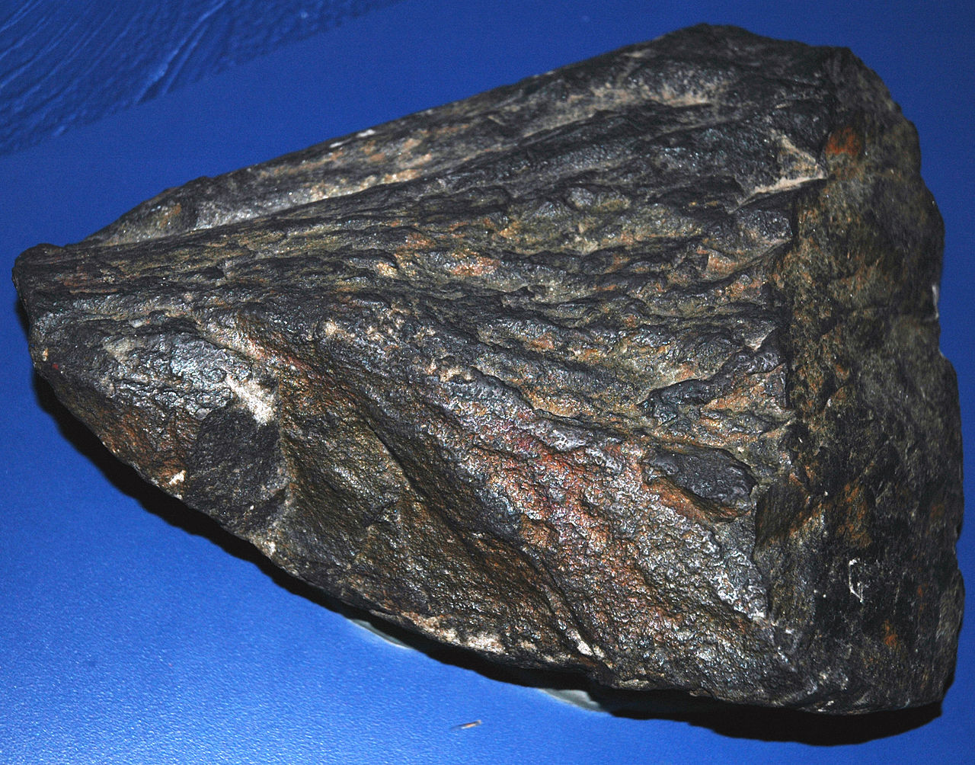
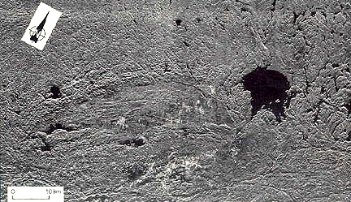
Sudbury, Kanada
Notes:
The Sudbury Basin, also known as Sudbury Structure or the Sudbury Nickel Irruptive, is a major geological structure in Ontario, Canada. It is the second-largest known impact crater orastrobleme on Earth, as well as one of the oldest.^{[1]}
The basin is located on the Canadian Shield in the city of Greater Sudbury, Ontario. The former municipalities of Rayside-Balfour, Valley East and Capreol lie within the Sudbury Basin, which is referred to locally as "The Valley". The urban core of the former city of Sudbury lies on the southern outskirts of the basin.
The Sudbury Basin is located near a number of other geological structures, including the Temagami Magnetic Anomaly, the Lake Wanapitei impact crater, the western end of the Ottawa-Bonnechere Graben, the Grenville Front Tectonic Zone and the eastern end of the Great Lakes Tectonic Zone, although none of the structures are directly related to each other in the sense of resulting from the same geophysical processes.
Contents
[hide]
1 Formation
2 Structure
3 Disputes over origin
4 Modern uses
5 References
6 External links
Formation[edit]
The Sudbury basin formed as a result of an impact into the Nuna supercontinent from a bolide approximately 10–15 km (6.2–9.3 mi) in diameter that occurred 1.849 billion years ago^{[2]} in thePaleoproterozoic era.
Image taken from Space Shuttle Challenger in 1984/1985
Debris from the impact was scattered over an area of 1,600,000 km² (620,000 sq mi) and traveled over 800 km (500 mi) away — rock fragments ejected by the impact have been found as far asMinnesota.^{[3]}
Models suggest that for such a large impact, debris was most likely scattered globally,^{[4]} but has since been eroded away. Its present size is believed to be a smaller portion of a 250 km (160 mi) round crater that the bolide originally created.
Subsequent geological processes have deformed the crater into the current smaller oval shape. Sudbury Basin is the second-largest crater on Earth, after the 300 km (190 mi) Vredefort craterin South Africa, and larger than the 180 km (110 mi) Chicxulub crater in Yucatán, Mexico.
Structure[edit]
NASA World Wind satellite image of the Sudbury astrobleme
Geological map of the Copper Cliff area, produced in the 1950s.
The full extent of the Sudbury Basin is 62 km (39 mi) long, 30 km (19 mi) wide and 15 km (9.3 mi) deep, although the modern ground surface is much shallower.
The main units characterizing the Sudbury Structure can be subdivided into three groups: the Sudbury Igneous Complex (SIC), the Whitewater Group, and footwall brecciated country rocks that include offset dikes and the Sublayer. The SIC is believed to be a stratified impact melt sheet composed from the base up of sublayer norite, mafic norite, felsic norite, quartz gabbro, and granophyre.
The Whitewater Group consists of a suevite and sedimentary package composed of the Onaping (fallback breccias), Onwatin, and Chelmsford Formations in stratigraphic succession. Footwall rocks, associated with the impact event, consist of Sudbury Breccia (pseudotachylite), footwall breccia, radial and concentric quartz dioritic breccia dikes (polymict impact melt breccias), and the discontinuous sublayer.
Because considerable erosion has occurred since the Sudbury event, an estimated 6 km (3.7 mi) in the North Range, it is difficult to directly constrain the actual size of the Sudbury crater, whether it being the diameter of the original transient cavity, or the final rim diameter.^{[5]}
The deformation of the Sudbury structure occurred in five main deformation events (by age):
formation of the Sudbury Igneous Complex (1849 Ma)^{[2]}
the Penokean orogeny (1890-1830 Ma)
the Mazatzal orogeny (1700-1600 Ma)^{[6]}
the Grenville orogeny (1400 - 1000 Ma)
the Lake Wanapitei impact (37 Ma)
Disputes over origin[edit]
Some 1.8 billions of years of weathering and deformation made it difficult to prove that a meteor was the cause of the Sudbury geological structures. A further difficulty in proving that the Sudbury complex was formed by meteor impact rather than by ordinary igneous processes was that the region was volcanically active at around the same time as the impact, and some weathered volcanic structures can look like meteor collision structures. Since then a layer of breccia has been found associated with the impact event^{[7]} and stressed rock formations have been fully mapped.
Geologists reached consensus by about 1970 that the Sudbury basin was formed by a meteor impact. Reports published in the late 1960s described geological features that were said to be distinctive of meteor impact, including shatter cones^{[8]} and shock-deformed quartz crystals in the underlying rock.^{[9]} In 2014, analysis of the concentration and distribution of siderophile elements as well as the size of the area where the impact melted the rock indicated that a comet rather than an asteroid most likely caused the crater.^{[10]} ^{[11]}
Modern uses[edit]
The large impact crater filled with magma containing nickel, copper, platinum, palladium, gold, and other metals. In 1856 while surveying a baseline westward from Lake Nipissing, provincial land surveyor Albert Salter located magnetic abnormalities in the area that were strongly suggestive of mineral deposits. The area was then examined by Alexander Murray of the Geological Survey of Canada, who confirmed "the presence of an immense mass of magnetic trap".
Due to the then-remoteness of the Sudbury area, Salter's discovery did not have much immediate impact. The later construction of the Canadian Pacific Railway through the area, however, made mineral exploration more feasible. The development of a mining settlement occurred in 1883 after blasting connected to the railway construction revealed a large concentration of nickel and copper ore at the Murray Mine site.
As a result of these metal deposits, the Sudbury area is one of the world's major mining communities. The region is one of the world's largest suppliers of nickel and copper ores. Most of these mineral deposits are found on the outer rim of the basin.
Due to the high mineral content of its soil, the floor of the basin is among the best agricultural land in Northern Ontario, with numerous vegetable, berry, and dairy farms located in the valley. Due to its northern latitude, it is not as productive as agricultural lands in the southern portion of the province. Accordingly, the region primarily supplies products for consumption within Northern Ontario, and is not a major food exporter.
An Ontario Historical Plaque was erected by the province to commemorate the discovery of the Sudbury Basin.^{[12]}

Slide 12
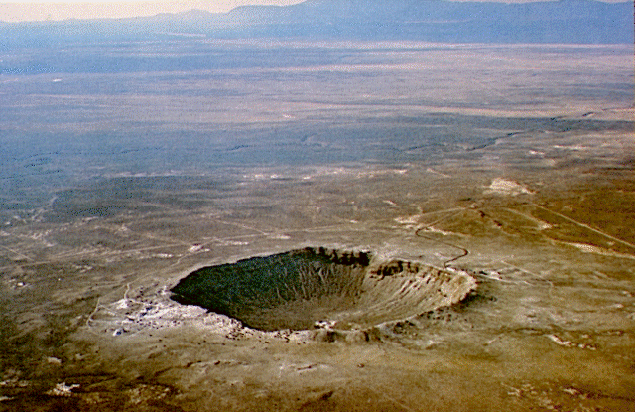
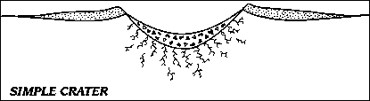
Barringerův kráter
Dopadem malého meteoritu (planetky) o průměru do 100-200 m vznikne jednoduchý kráter, jako například Barringerův kráter v Arizoně.

Slide 13
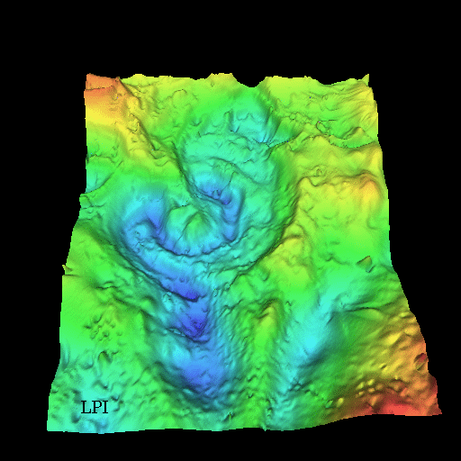
Kráter Chicxulub - Yucatán
(dopad na hranici druhohor a třetihor)
- tíhová mapa:
Dopadem velkého meteoritu (planetky) vznikne komplexní kráter, jako například kráter Chicxulub.

Slide 14
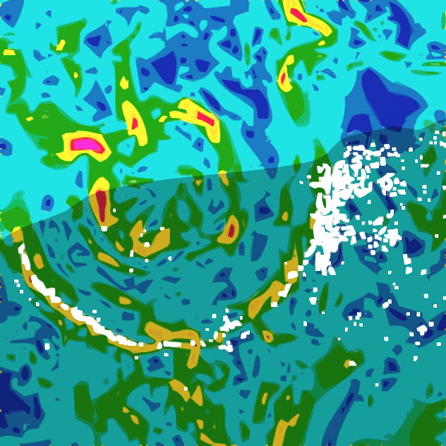
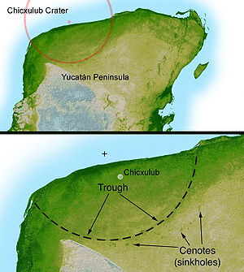
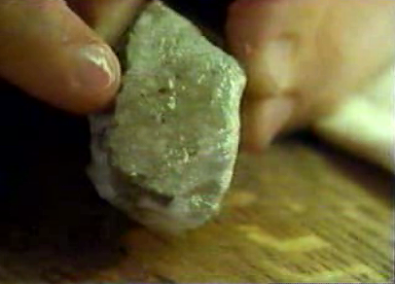
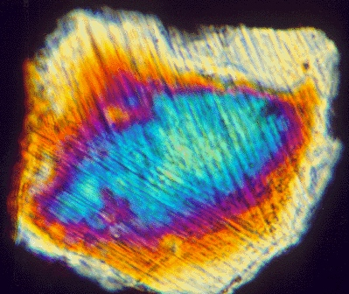
Xicxulub kráter, Yukatán, Mexiko
Gravimetrická mapa kráteru Xicxulub
Fšokové křemeny,
Def. lamelování
Křem. zrn
Notes:
he Chicxulub crater (/ˈtʃiːkʃʉluːb/; Mayan pronunciation: [tʃʼikʃuluɓ]) is a prehistoric impact crater buried underneath the Yucatán Peninsula in Mexico.^{[2]} Its center is located near the town of Chicxulub, after which the crater is named.^{[3]} The age of the Chicxulub asteroid impact and the Cretaceous–Paleogene boundary (K–Pg boundary) coincide precisely.^{[4]}The crater is more than 180 kilometres (110 mi) in diameter and 20 km (12 mi) in depth, making the feature one of the largest confirmed impact structures on Earth; the impactingbolide that formed the crater was at least 10 km (6 mi) in diameter.
The crater was discovered by Antonio Camargo and Glen Penfield, geophysicists who had been looking for petroleum in the Yucatán during the late 1970s. Penfield was initially unable to obtain evidence that the geological feature was a crater, and gave up his search. Through contact with Alan Hildebrand, Penfield obtained samples that suggested it was an impact feature. Evidence for the impact origin of the crater includes shocked quartz, a gravity anomaly, and tektites in surrounding areas.
The age of the rocks marked by the impact shows that this impact structure dates from roughly 66 million years ago, the end of the Cretaceous period, and the start of thePaleogene period. It coincides with the K-Pg boundary, the geological boundary between the Cretaceous and Paleogene. The impact associated with the crater is thus implicated in the Cretaceous–Paleogene extinction event, including the worldwide extinction of non-avian dinosaurs. This conclusion has been the source of controversy. In March 2010, 41 experts from many countries reviewed the available evidence: 20 years' worth of data spanning a variety of fields. They concluded that the impact at Chicxulub triggered the mass extinctions at the K–Pg boundary.^{[5][6]}
Contents
[hide]
1 Discovery
2 Impact specifics
2.1 Effects
2.2 Geology and morphology
2.3 Astronomical origin of asteroid
2.4 Chicxulub and mass extinction
3 Multiple impact theory
4 See also
5 Notes
6 References
7 Further reading
8 External links
Discovery[edit]
Artist's rendering of the gravity anomaly map of the Chicxulub Crater area. Different colors represent different gravity measurements, except the white dots, which are sinkholes called cenotes. The shaded area is the Yucatán Peninsula.^{[7]}
In 1978, geophysicists Antonio Camargo and Glen Penfield were working for the Mexican state-owned oil company Petróleos Mexicanos, or Pemex, as part of an airborne magnetic survey of theGulf of Mexico north of the Yucatán peninsula.^{[8]} Penfield's job was to use geophysical data to scout possible locations for oil drilling.^{[9]} In the data, Penfield found a huge underwater arc with "extraordinary symmetry" in a ring 70 km (40 mi) across.^{[3]} He then obtained a gravity map of the Yucatán made in the 1960s. A decade earlier, the same map suggested an impact feature to contractor Robert Baltosser, but he was forbidden to publicize his conclusion by Pemex corporate policy of the time.^{[10]} Penfield found another arc on the peninsula itself, the ends of which pointed northward. Comparing the two maps, he found the separate arcs formed a circle, 180 km (111 mi) wide, centered near the Yucatán village Chicxulub; he felt certain the shape had been created by a cataclysmic event in geologic history.
Pemex disallowed release of specific data but let Penfield and company official Antonio Camargo present their results at the 1981 Society of Exploration Geophysicists conference.^{[11]} That year's conference was underattended and their report attracted scant attention. Coincidentally, many experts in impact craters and the K–Pg boundary were attending a separate conference on Earth impacts. Although Penfield had plenty of geophysical data sets, he had no rock cores or other physical evidence of an impact.^{[9]}
He knew Pemex had drilled exploratory wells in the region. In 1951, one bored into what was described as a thick layer of andesite about 1.3 km (4,200 ft) down. This layer could have resulted from the intense heat and pressure of an Earth impact, but at the time of the borings it was dismissed as a lava dome — a feature uncharacteristic of the region's geology. Penfield tried to secure site samples, but was told such samples had been lost or destroyed.^{[9]} When attempts at returning to the drill sites and looking for rocks proved fruitless, Penfield abandoned his search, published his findings and returned to his Pemex work.
Penfield with the sample of shocked quartz found at Well #2, Chicxulub
At the same time, scientist Luis Walter Alvarez put forth his hypothesis that a large extraterrestrial body had struck Earth and, unaware of Penfield's discovery, in 1981 University of Arizona graduate student Alan R. Hildebrand and faculty adviser William V. Boynton published a draft Earth-impact theory and sought a candidate crater.^{[12]} Their evidence included greenish-brown clay with surplus iridium containing shocked quartz grains and small weatheredglass beads that looked to be tektites.^{[13]} Thick, jumbled deposits of coarse rock fragments were also present, thought to have been scoured from one place and deposited elsewhere by a kilometres-high tsunami resulting from an Earth impact.^{[14]} Such deposits occur in many locations but seem concentrated in the Caribbean basin at the K–Pg boundary.^{[14]} So when Haitian professor Florentine Morás discovered what he thought to be evidence of an ancient volcano on Haiti, Hildebrand suggested it could be a telltale feature of a nearby impact.^{[15]} Tests on samples retrieved from the K–Pg boundary revealed more tektite glass, formed only in the heat of asteroid impacts and high-yield nuclear detonations.^{[15]}
In 1990, Houston Chronicle reporter Carlos Byars told Hildebrand of Penfield's earlier discovery of a possible impact crater.^{[16]} Hildebrand contacted Penfield in April 1990 and the pair soon secured two drill samples from the Pemex wells, stored in New Orleans.^{[17]} Hildebrand's team tested the samples, which clearly showed shock-metamorphic materials.
A team of California researchers including Kevin Pope, Adriana Ocampo, and Charles Duller, surveying regional satellite images in 1996, found a sinkhole (cenote) ring centered on Chicxulub that matched the one Penfield saw earlier; the sinkholes were thought to be caused by subsidence of the impact crater wall.^{[18]} More recent evidence suggests the actual crater is 300 km (190 mi) wide, and the 180 km ring is in fact an inner wall of it.^{[19]}
Impact specifics[edit]
An animation showing the impact, and subsequent crater formation (University of Arizona, Space Imagery Center). Click here to see the animation
Researchers at the University of Glasgow dated rock and ash samples from the impact to 66,038,000 ± 11,000 years ago.^{[20]}
The Chicxulub impactor had an estimated diameter of 10 km (6.2 mi) and delivered an estimated energy equivalent of 100 teratons of TNT (4.2×10²³ J).^{[21]} By contrast, the most powerful man-made explosive device ever detonated, the Tsar Bomba, had a yield of only 50 megatons of TNT (2.1×10¹⁷ J),^{[22]} making the Chicxulub impact 2 million times more powerful. Even the most energetic known volcanic eruption, which released an estimated energy equivalent of approximately 240 gigatons of TNT (1.0×10²¹ J) and created the La Garita Caldera,^{[23]} delivered only 0.24% of the energy of the Chicxulub impact.
Effects[edit]
The impact would have caused some of the largest megatsunamis in Earth's history. A cloud of super-heated dust, ash and steam would have spread from the crater as the impactor burrowed underground in less than a second.^{[24]} Excavated material along with pieces of the impactor, ejected out of the atmosphere by the blast, would have been heated to incandescence upon re-entry, broiling the Earth's surface and possibly igniting wildfires; meanwhile, colossal shock waves would have triggered global earthquakes and volcanic eruptions.^{[25]} The emission of dust and particles could have covered the entire surface of the Earth for several years, possibly a decade, creating a harsh environment for living things. The shock production of carbon dioxide caused by the destruction of carbonate rocks would have led to a sudden greenhouse effect.^{[26]} Over a longer period, sunlight would have been blocked from reaching the surface of the Earth by the dust particles in the atmosphere, cooling the surface dramatically.Photosynthesis by plants would also have been interrupted, affecting the entire food chain.^{[27][28]} A model of the event developed by Lomax et al. (2001) suggests that net primary productivity (NPP) rates may have increased to higher than pre-impact levels over the long term because of the high carbon dioxide concentrations.^{[29]} A long-term effect of the impact was the creation of the sedimentary basin which "ultimately produced favorable conditions for human settlement in a region where surface water is scarce."^{[30]}
In February 2008, a team of researchers led by Sean Gulick at the University of Texas at Austin's Jackson School of Geosciences used seismic images of the crater to determine that the impactor landed in deeper water than was previously assumed. They argued that this would have resulted in increased sulfate aerosols in the atmosphere. According to the press release, that "could have made the impact deadlier in two ways: by altering climate (sulfate aerosols in the upper atmosphere can have a cooling effect) and by generating acid rain (water vapor can help to flush the lower atmosphere of sulfate aerosols, causing acid rain)."^{[31]}
Geology and morphology[edit]
The piece of clay, held by Walter Alvarez, that sparked research into the impact theory. The greenish-brown band in the center is extremely rich iniridium.
In their 1991 paper, Hildebrand, Penfield, and company described the geology and composition of the impact feature.^{[32]} The rocks above the impact feature are layers of marl and limestonereaching to a depth of almost 1,000 m (3,300 ft). These rocks date back as far as the Paleocene.^{[33]} Below these layers lie more than 500 m (1,600 ft) of andesite glass and breccia. These andesitic igneous rocks were only found within the supposed impact feature, as is shocked quartz.^{[33]} The K–Pg boundary inside the feature is depressed to 600 to 1,100 m (2,000 to 3,600 ft) compared with the normal depth of about 500 m (1,600 ft) measured 5 kilometres (3.1 mi) away from the impact feature.^{[34]} Along the edge of the crater are clusters of cenotes or sinkholes,[1]which suggest that there was a water basin inside the feature during the Neogene period, after the impact.^{[34]} The groundwater of such a basin would have dissolved the limestone and created the caves and cenotes beneath the surface.^{[35]} The paper also noted that the crater seemed to be a good candidate source for the tektites reported at Haiti.^{[36]}
Astronomical origin of asteroid[edit]
In September 2007, a report published in Nature proposed an origin for the asteroid that created Chicxulub Crater.^{[27]} The authors, William F. Bottke, David Vokrouhlický, and David Nesvorný, argued that a collision in the asteroid belt 160 million years ago resulted in the Baptistina family of asteroids, the largest surviving member of which is 298 Baptistina. They proposed that the "Chicxulub asteroid" was also a member of this group. The connection between Chicxulub and Baptistina is supported by the large amount of carbonaceous material present in microscopic fragments of the impactor, suggesting the impactor was a member of a rare class of asteroids called carbonaceous chondrites, like Baptistina.^{[37]} According to Bottke, the Chicxulub impactor was a fragment of a much larger parent body about 170 km (110 mi) across, with the other impacting body being around 60 km (40 mi) in diameter.^{[37][38]} In 2011, new data from the Wide-field Infrared Survey Explorer revised the date of the collision which created the Baptistina family to about 80 million years ago. This makes an asteroid from this family highly improbable to be the asteroid that created the Chicxulub Crater, as typically the process of resonance and collision of an asteroid takes many tens of millions of years.^{[39]} In 2010, another hypothesis was offered which implicated the newly discovered asteroid P/2010 A2, a member of the Flora family of asteroids, as a possible remnant cohort of the K/Pg impactor.^{[40]}
Chicxulub and mass extinction[edit]
Main article: Cretaceous–Paleogene extinction event
The Chicxulub Crater lends support to the theory postulated by the late physicist Luis Alvarez and his son, geologist Walter Alvarez, that the extinction of numerous animal and plant groups, including dinosaurs, may have resulted from a bolide impact (the Cretaceous–Paleogene extinction event). Luis and Walter Alvarez, at the time both faculty members at the University of California, Berkeley, postulated that this enormous extinction event, which was roughly contemporaneous with the postulated date of formation for the Chicxulub crater, could have been caused by just such a large impact.^{[41]} This theory is now widely accepted by the scientific community. Some critics, includingpaleontologist Robert Bakker, argue that such an impact would have killed frogs as well as dinosaurs, yet the frogs survived the extinction event.^{[42]} Gerta Keller of Princeton University argues that recent core samples from Chicxulub prove the impact occurred about 300,000 years before the mass extinction, and thus could not have been the causal factor.^{[43]}
The main evidence of such an impact, besides the crater itself, is contained in a thin layer of clay present in the K–Pg boundary across the world. In the late 1970s, the Alvarezes and colleagues reported that it contained an abnormally high concentration of iridium.^{[44]} Iridium levels in this layer reached 6 parts per billion by weight or more compared to 0.4 for the Earth's crust as a whole;^{[45]} in comparison, meteorites can contain around 470 parts per billion of this element.^{[46]} It was hypothesized that the iridium was spread into the atmosphere when the impactor was vaporized and settled across the Earth's surface amongst other material thrown up by the impact, producing the layer of iridium-enriched clay.^{[47]}
Multiple impact theory[edit]
In recent years, several other craters of around the same age as Chicxulub have been discovered, all between latitudes 20°N and 70°N. Examples include the disputed^{[48]} Silverpit crater in the North Sea^{[49]} and the Boltysh crater inUkraine.^{[50]} Both are much smaller than Chicxulub, but are likely to have been caused by objects many tens of metres across striking the Earth.^{[51]} This has led to the hypothesis that the Chicxulub impact may have been only one of several impacts that happened nearly at the same time.^{[52]} Another possible crater thought to have been formed at the same time is the larger Shiva crater,^{[53]} though the structure's status as a crater is contested.^{[54]}
The collision of Comet Shoemaker–Levy 9 with Jupiter in 1994 demonstrated that gravitational interactions can fragment a comet, giving rise to many impacts over a period of a few days if the comet should collide with a planet. Comets undergo gravitational interactions with the gas giants, and similar disruptions and collisions are very likely to have occurred in the past.^{[53][55]} This scenario may have occurred on Earth at the end of the Cretaceous,^{[52]} though Shiva and the Chicxulub craters might have been formed 300,000 years apart.^{[53]}
In late 2006, Ken MacLeod, a geology professor from the University of Missouri, completed an analysis of sediment below the ocean's surface, bolstering the single-impact theory. MacLeod conducted his analysis approximately 4,500 km (2,800 mi) from the Chicxulub Crater to control for possible changes in soil composition at the impact site, while still close enough to be affected by the impact. The analysis revealed there was only one layer of impact debris in the sediment, which indicated there was only one impact.^{[56]} Multiple-impact proponents such as Gerta Keller regard the results as "rather hyper-inflated" and do not agree with the conclusion of MacLeod's analysis,^{[57]} arguing that there might only be gaps of hours to days between impacts in a multiple impact scenario (cf. Shoemaker-Levy 9) which would not leave a detectable gap in deposits.

Slide 15
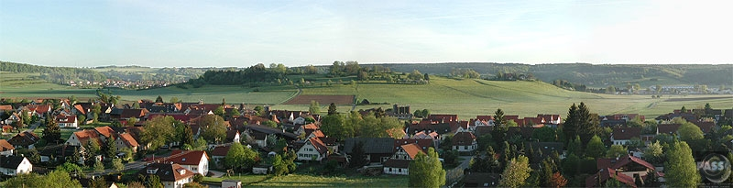
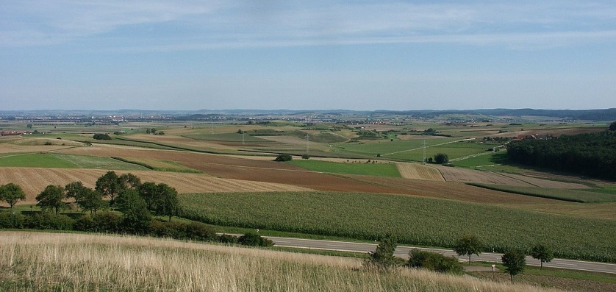
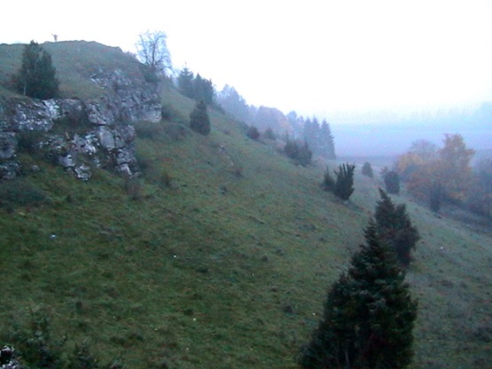
Ries, Steinheim,
Zdrojová oblast vltavínů, kráter o průměru cca 2,5 km vznikl dopadem dvojčete meteoritu, který vytvořil Ries –14,5 Ma
Je dobře patrný centrální pahorek i kráterové valy v okolí.
Notes:
The Nördlinger Ries is a large circular depression in western Bavaria, Germany, located north of the Danube in the district of Donau-Ries. The city of Nördlingen is located about 6 kilometers (3.7 mi) southwest of the centre of the depression.
The word "Ries" is not a German word; it is believed that the term is derived from Raetia, since the tribe of Raetians lived in the area in pre-Roman times.
Ries impact crater[edit]
The depression is interpreted as a meteor impact crater formed about 14.3 million–14.5 million years ago in the Miocene.^{[1][2]} The crater is most commonly referred to simply as the Ries or Ries crater. The original crater rim had an estimated diameter of 24 kilometers (15 mi). The present floor of the depression is about 100 to 150 m (330 to 490 ft) below the eroded remains of the rim.
It was originally assumed that the Ries was of volcanic origin. In 1960 Eugene Shoemaker andEdward C. T. Chao showed that the depression was caused by meteorite impact.^{[3]} The key evidence was the presence of coesite, which, in unmetamorphosed rocks, can only be formed by the shock pressures associated with meteorite impact. The coesite was found in the locally derived suevite building stone of the Nördlingen town church.^{[4]} The suevite was formed from mesozoic sediments shocked by the bolide impact.^{[5][6]}
Another impact crater, the much smaller (3.8 km diameter) Steinheim crater,^{[7]} is located about 42 km (26 mi) west-southwest from the centre of Ries. The two craters are believed to have formed nearly simultaneously by the impact of a binary asteroid.
Recent computer modeling of the impact event indicates that the impactors probably had diameters of about 1.5 kilometers (4,900 ft) (Ries) and 150 meters (490 ft) (Steinheim), had a pre-impact separation of some tens of kilometers, and impacted the target area at an angle around 30 to 50 degrees from the surface in a west-southwest to east-northeast direction. The impact velocity is thought to have been about 20 km/s (45,000 mph). The resulting explosion had the power of 1.8 million Hiroshima bombs, an energy of roughly 2.4×10²¹ joules.
The Ries crater impact event is believed to be the source of moldavite tektites found in Bohemiaand Moravia (Czech Republic).^{[8]} The tektite melt originated from a sand-rich surface layer that was ejected to distances up to 450 km (280 mi) downrange of the crater.
Stone buildings in Nördlingen contain millions of tiny diamonds, all less than 0.2 mm (0.0079 in) across. The impact that caused the Nördlinger Ries crater created an estimated 72,000 tonnes (79,000 short tons) of them when it impacted a local graphite deposit. Stone from this area was quarried and used to build the local buildings.^{[9]}

Slide 16
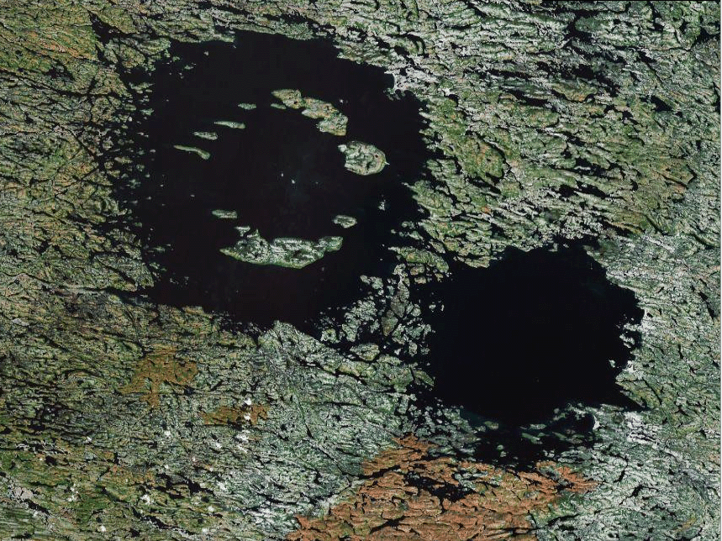

Slide 17
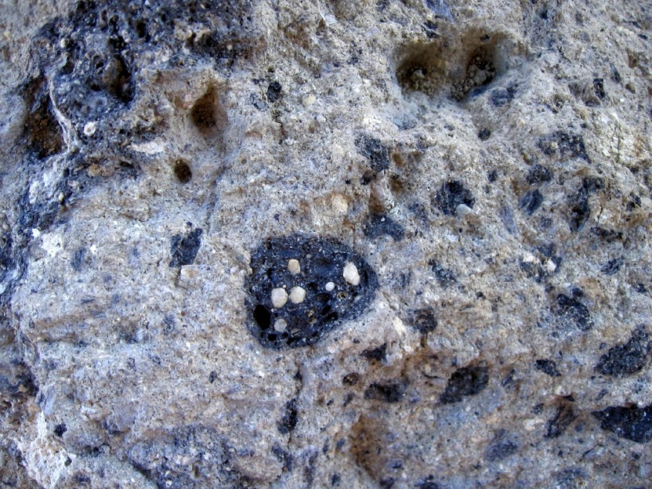
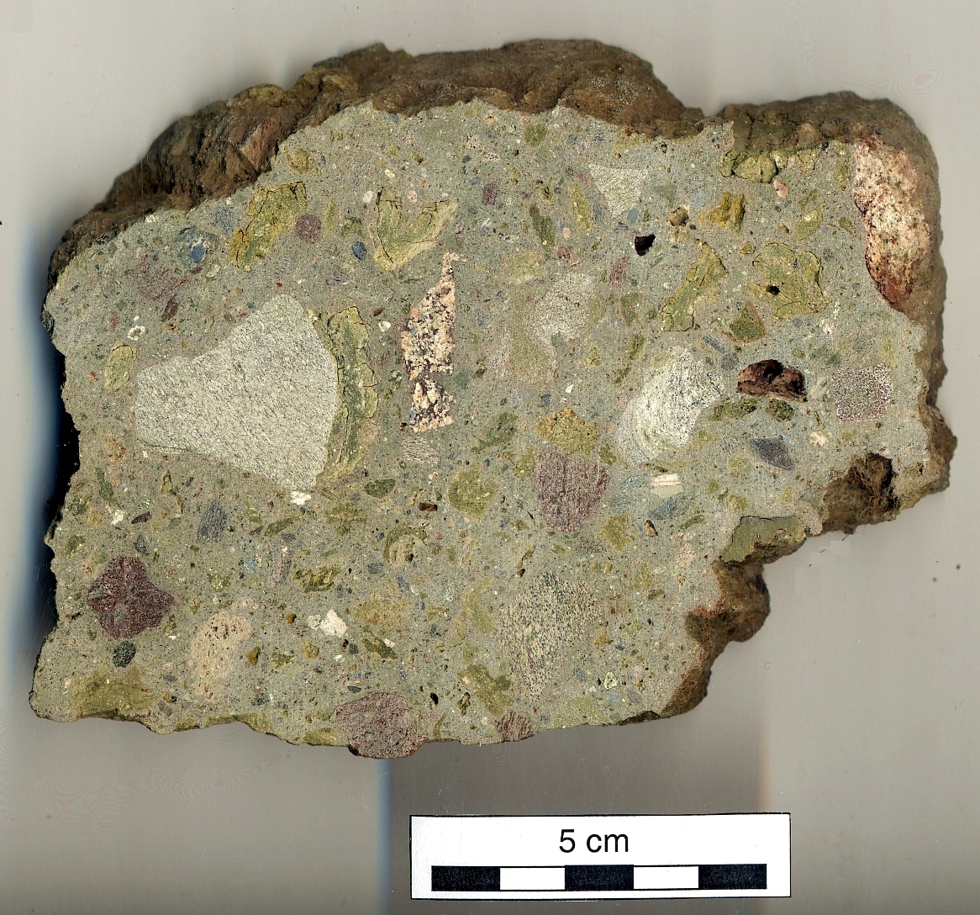
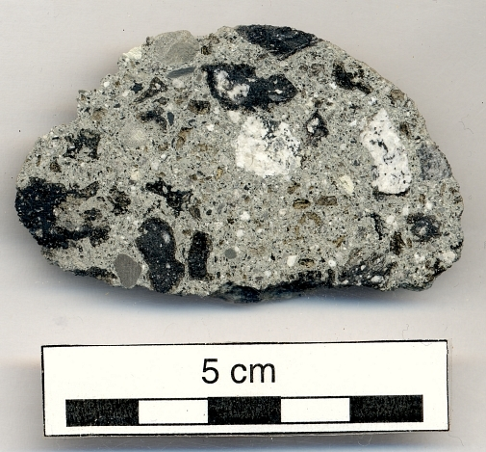
Příklady impaktních brekcií skládajících se ze spečených úlomků roztavených úlomků
s úlomky nenatavenými

Slide 18
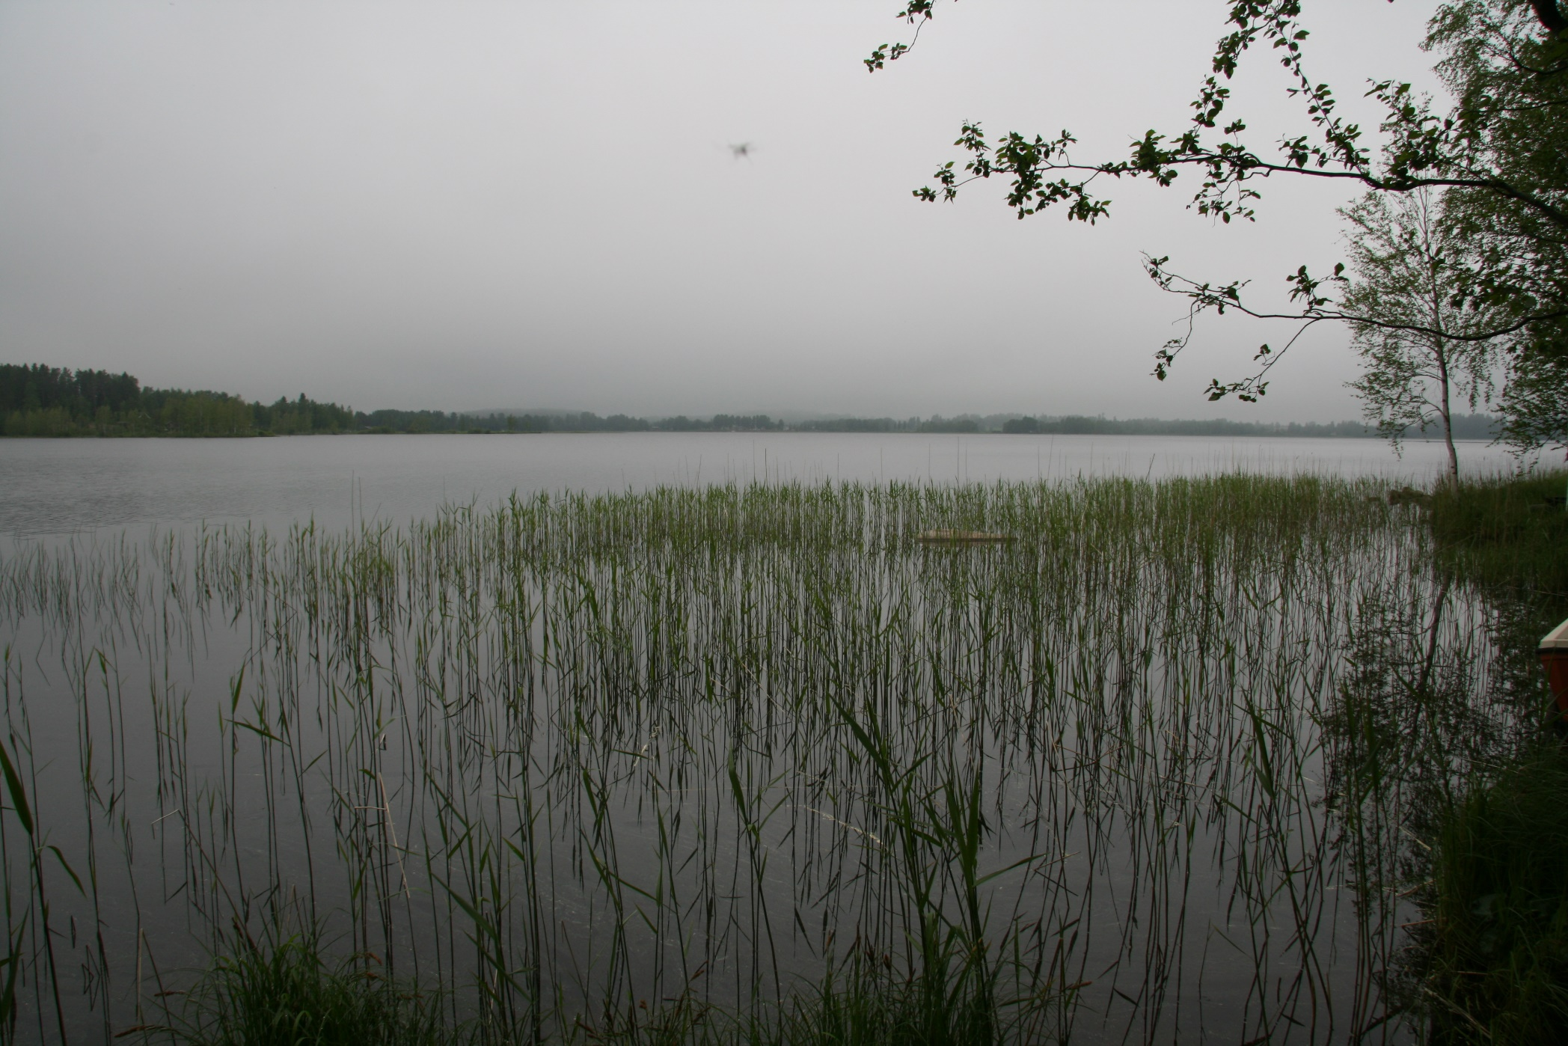
Impaktní kráter Lappajärvi, Finsko,

Slide 19
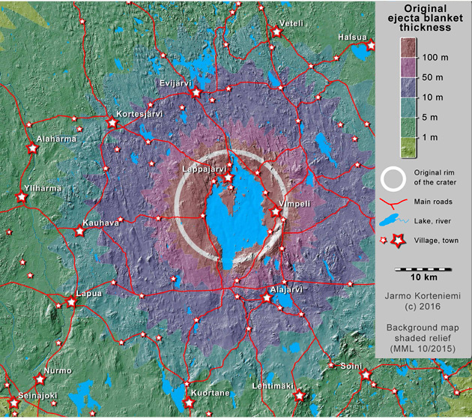
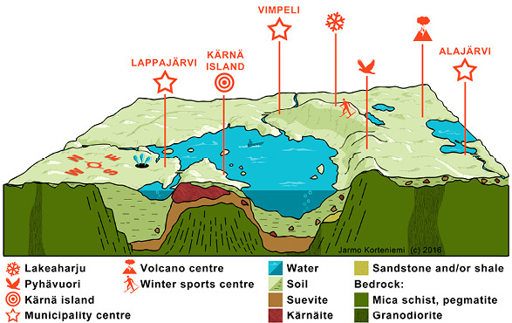
Kráter Lappajärvi, Finsko,
76 – 73 Ma

Slide 20
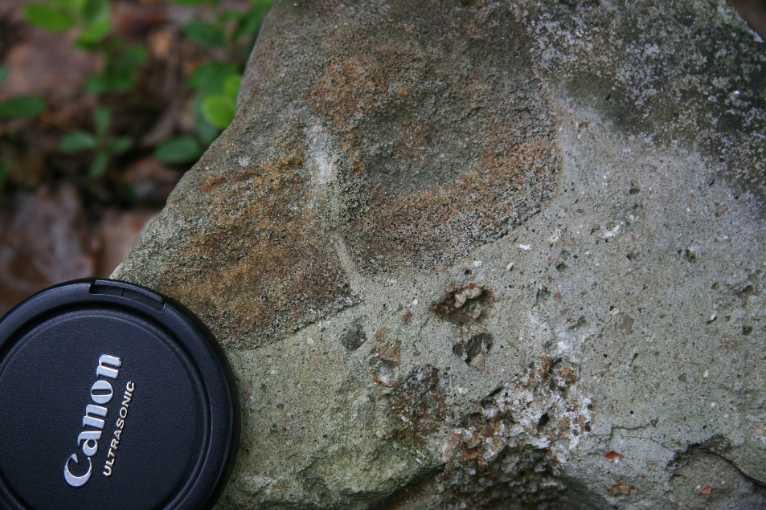
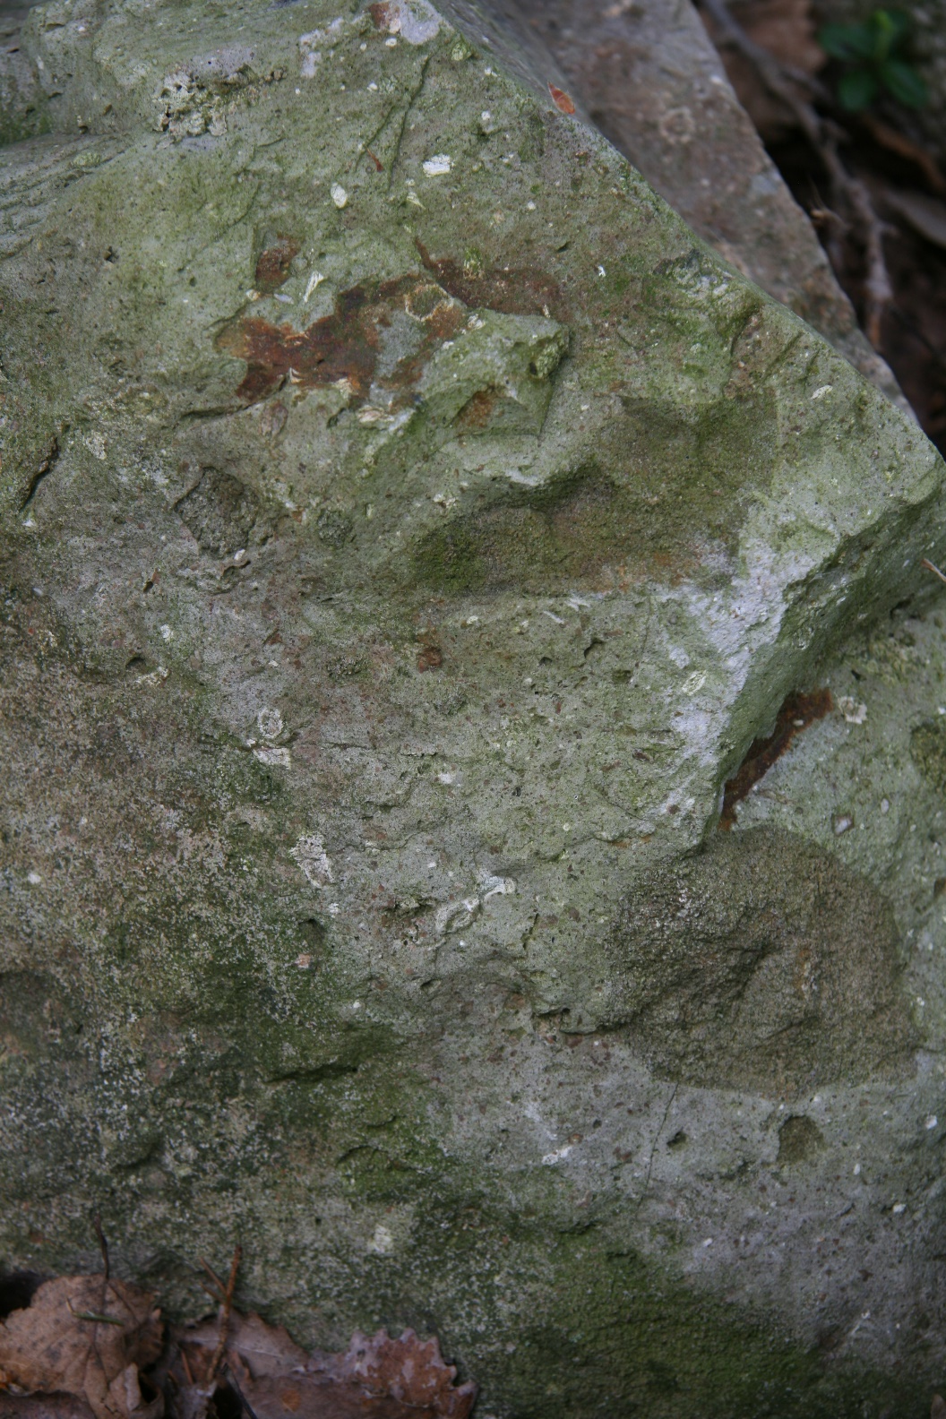
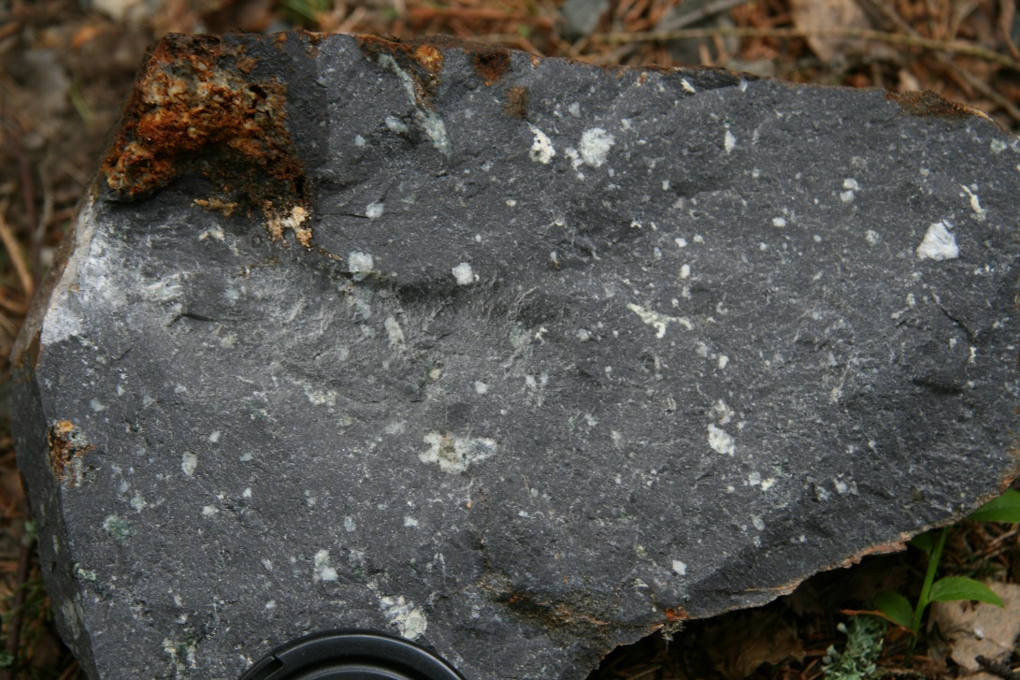
Impaktové brekcie kráteru Lappajärvi, Finsko

Slide 21
Oficiálně uznávané impakty v roce 2007
Uznáváno 204 dopadů (někdy více kráterů), z toho jen 119 s oboustranně vymezeným stářím

Slide 22
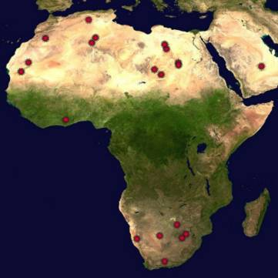
většina známých impaktů:
je poměrně mladých, ale často na staré kůře; téměř všechny na pevnině
byla nalezena na území geologických velmocí (Kanada, USA, býv. SSSR, Austrálie, Skandinávie; např. v Číně ani jeden), zpravidla se sušším klimatem (v současnosti!)

Slide 23
možný počet impaktů větších než 50 km - extrapolace:
jen 15 známých impaktů má průměr > 50 km; všechny na pevninách nebo šelfech
na pevninách by mělo být objeveno dalších 108 (extrapolace podle všech impaktů), v moři nejméně 40, které jsou mladší než 2,5 miliardy let a vzhledem k hloubce šokové přeměny (>7 km) nemohly být erozí úplně smazány
zatím není znám zachovalý impakt z archaika (prahor) (>2,5 miliardy let)

Slide 24
Projevy impaktu
Šoková přeměna hornin: aspoň dvě tlakové vlny (dopad + výbuch tělesa)
  vysokotlaké fáze (SiO2 – coesit, stišovit; diamant)
  drcení, vznik brekcií, „injekce“ v pevném stavu
stlačené horniny se „odrazí“– vznik přechodné dutiny
Teplota > 3000 °C již u kráterů větších než 1-2 km (žádné zbytky meteoritů - vypaření); tavení
např. kinetická energie při vzniku kráteru Popigaj (d = 100 km) je srovnatelná s potenciální e. vyzdvižených horninových mas Alp
při hroucení přechodné dutiny se smísí bloky různých hornin a tavenina („megabrekcie“)

Slide 25
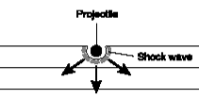
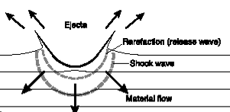
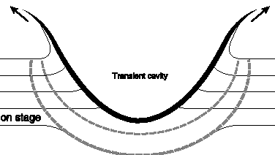
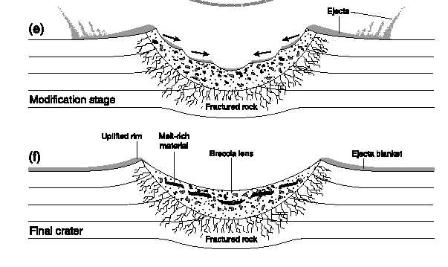
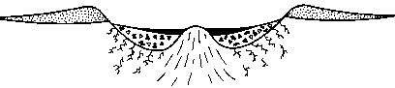

Slide 26
Kráterová tavenina
Roztavení hornin v místě dopadu
  působením šokové vlny začíná tavení asi od 40 GPa (od 1000 °C)
více se taví lépe stlačitelné minerály/horniny
Kontaminace impaktujícím tělesem (tzv. siderofilní prvky – nejprůkaznější Ir; též Ni, Cr)
Možný výlev magmatu ze zemského pláště
Sudbury (největší ložiska Pt, Ni aj.)
měsíční „moře“: vznikla z největších impaktů?

Slide 27
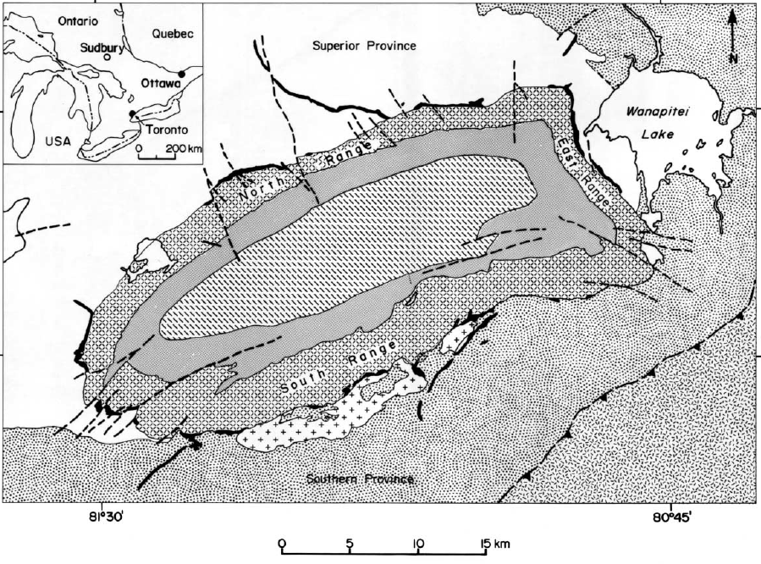
Sudbury

Slide 28
kontaminace iridiem

Slide 29
Odchylky kráterové taveniny od složení roztaveného materiálu (bez kontaminace)
silně redukovaná (vysoké teploty)
  rozklad H2O, CO2 za vzniku H2, CO, které při chladnutí reagují na uhlovodíky
  nízký poměr FeO/Fe2O3; i kuličky kovového Fe
  při zvětrávání skla však může být Fe rychle oxidováno
vypařování: ztráta F, Sb, trochu i alkálií, Si
  pasivně se zvyšuje obsah Al, Ti, Th, větš. i Ca, Mg
  složité, někdy jen kompenzuje účinek výběrového tavení; závislost na teplotě

Slide 30
vypařování
(experimenty ve vakuu – Bazilevskij et al., 1983)

Slide 31
impaktová skla "autochtonní" (relat. nepřemístěná tavenina)
sklovitě tuhne spíše kyselejší tavenina (více SiO2) - viskóznější, pomalejší růst krystalů
  až >2000 °C
Darwinské a macedonské sklo
Libyjské sklo - 98% SiO2 - lechatelierit
  kráter již erodován; prohřáto z nadloží? (delší tavení, chladnutí ≤1°C / s)
Žamanšinity
  chybí kontaminace meteoritem (Větvička a kol., 2004); vypařil se dříve než mohlo dojít ke smísení?

Slide 32
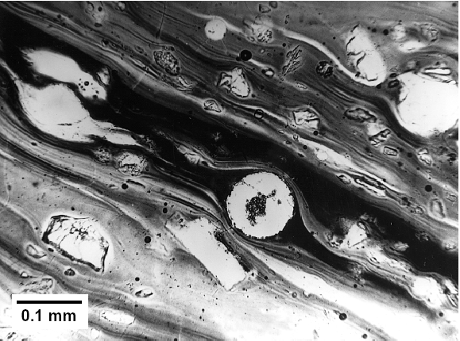
impaktní tavenina – Ries
-sklo, zbytky křemene, lechatelierit

Slide 33
Sférule
z kapek taveniny; velikost max. první mm
v Č(SS)R už dlouho systematicky mapovány s těžkými minerály (většinou antropogenní původ)
nejznámější: z kráteru Chicxulub (65 mil. let)
  až >7000 km daleko vrstva mocná 2-3 mm; únik a opětovný návrat vyvrženin do atmosféry?
nejisté sférule (vrstvy mocné až 1m! s vysokým Ir) ve starých vrstvách (>2500 Ma) v Austrálii; nepatří k žádnému známému impaktu (Lowe, Byerly 1986; Simonson et al., 1997)

Slide 34
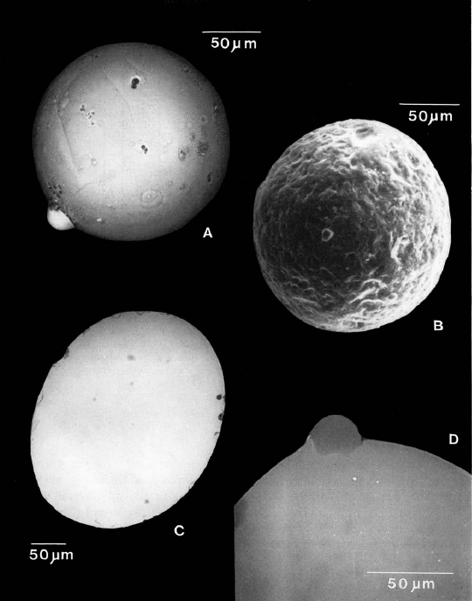
sférule z vrstvy staré cca 370 Ma (globální událost)
(Claeys a Casier, 1994)
- velmi bohaté Al (až ~30 % Al2O3)

Slide 35
Tektity
homogennější než autochtonní impaktová skla (vysoká teplota - až téměř 2000 °C)
tlak plynů 0,001-0,05 atm. – odpovídá stratosféře
chladnutí až > 200 °C / min. (až 400 - menší vltavíny)
prodělaly transport vzduchem; tvarování rotací
mohou mít silné vnitřní pnutí: např. dvoubarevné vltavíny - spojení kapek při letu?

Slide 36
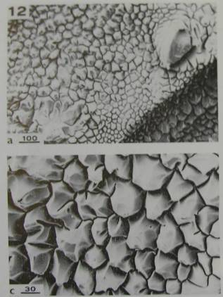
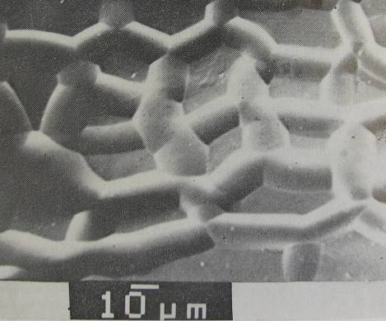
skulptace
selektivním zvětráváním (hmota bohatší SiO2 je
odolnější); predisponována pnutím (M. Trnka)
event. znovu zaoblení při transportu vodním tokem

Slide 37
tektity
Vltavíny (moldavity) (popsal již J. Mayer, 1787)
  považovány i za olivín, sopečné sklo (i z Měsíce), strusku, úlomky skleněných meteoritů
  14,8 Ma; původ: kráter Ries; nejmenší objem
Severoamerické tektity a mikrotektity (nejobjemnější, nejstarší - 35 Ma)
Australsko-asijské tektity a mikrotektity (nejmladší - 800 000 let)
Ivority a mikroivority; původ: kráter Bosumtwi

Slide 38
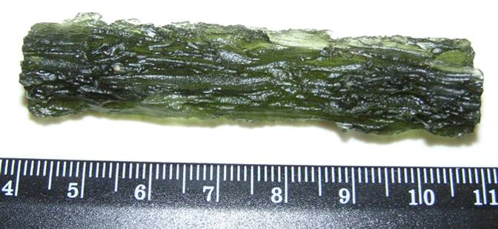
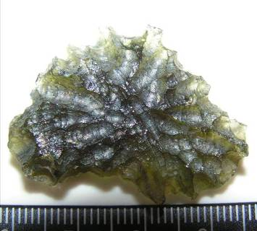
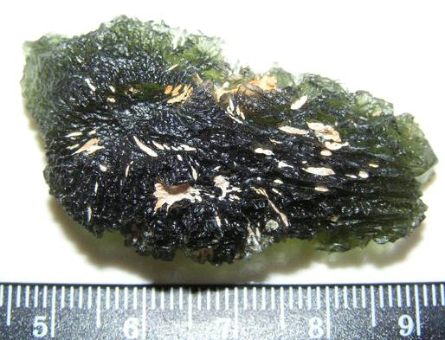
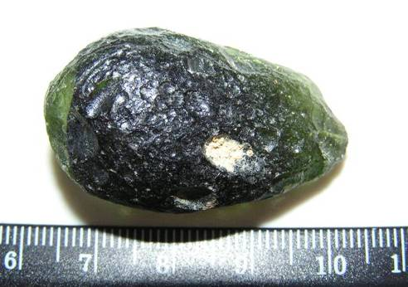

Slide 39
Složení tektitů
původ ze sedimentů (písek-jíl)
velmi málo H2O (<0,02 %)
ochuzeny o těkavé prvky (F, Tl, Sb, Cs, Sn, W), Cu, Pb, trochu Na
vysoký SiO2 (vltavíny, georgianity Ø 79-83 %
  v lávě nemožné); vulk. skla max. cca 76 %
lechatelierit - "křemenné" sklo
redukované (i více než impaktní skla)
coesit, badelleyit; krystaly vždy < 0,1 mm
+ deformované zbytky různých min. (rutil, chromit...)
Kontaminace Ir apod. nezjištěna.

Slide 40
Složení moldavitů
sklo: relat. vysoké Ca, Mg, poměr K/Na
lechatelierit (neexistuje ve vulk. sklech)
proudová textura, šlíry
krystalky – coesit, baddeleyit
- kovové Fe; i elementární Si (Cílek, 1985)
Podle místa dopadu: na Z více SiO2, na V více Fe
složení neodpovídá kráterové tavenině v Riesu
  jiné zdrojové horniny

Slide 41


tvarování lechatelieritu - důkaz nízké viskozity → vysoká teplota (max. ~1800°C – jen krátce)

Slide 42


Zdrojová oblast vltavínů - Ries kráter o průměru cca 24 km vznikl dopadem tělesa o průměru cca 1,5 km.

Slide 43

Pádová pole vltavínů a trajektorie letu v závislosti na objemové hustotě
- hustší tektity dopadají dále od kráteru Ries
2,5
2,25

Slide 44

Závislost trajektorie letu na počáteční rychlosti - existuje optimální rychlost, pro kterou materiál doletí nejdále. Pro větší rychlosti se dříve vypaří.

Slide 45

Závislost trajektorie letu na koeficientu odporu vzduchu pro těleso o hmotnosti 100t a počáteční rychlosti 3500 m/s

Slide 46

Závislost teploty, rychlosti a hmotnosti na vzdálenosti od Riesu - největší úbytek hmotnosti (až 100%) je při prvním průchodu atmosférou. Zde dochází k prohřívání materiálu a jeho homogenizaci.
Průlet atmosférou

Slide 47
shrnutí - vltavíny
Diferenciaci pádových polí (Radomilice, české a moravské) je možno jen částečně vysvětlit rozdílnou objemovou hostotou zdrojového materiálu a hustotním separátorem atmosférou.
Největší diferenciaci pádových polí způsobuje různá odolnost zdrojového materiálu k prohřívání při průletu atmosférou. Radomilické vltavíny vznikly z čistého písku, jihočeské vltavíny z písku s malou příměsí jílu a moravské a lužické vltavíny většinou z písčitých jílů (V. Bouška). Proto největší úbytek hmotnosti vůči vyvrženému objemu materiálu je zaznamenán u českých vltavínů a menší u moravských vltavínů.

Slide 48
K největšímu prohřívání materiálu dochází při průletu atmosférou. Samotný impakt generuje jen šokovou vlnu s vysokou teplotou a tlakem, která má však krátké trvání (s).
Zvyšování startovací rychlosti vede k rychlejšímu vypaření materiálu a nikoli k většímu doletu tektitů. Existuje optimální startovací rychlost pro daný objem vyvrženého materiálu.
Materiál, „vyfouknutý“ zpod impaktoru na čele tlakové vlny by v případě vltavínů měl přibližně objem koule o průměru 24 m.

Slide 49
Měsíční skla
zachovávají se mnohem déle (běžně > 3 Ga)
selektivní tavení: živec (na M. anortit) > olivín
frakcionace prvků vypařováním účinnější (vakuum), lépe odpovídá experimentům
1. reziduální skla (obohacena Al, Ca, Mg, Ti)
2. kondenzáty par (bohatší Na, Si, Fe)

Slide 50




Slide 51
planární deformace minerálů: počínající amorfizace?
působením šokové vlny (= tlaková vlna šířící se rychleji než zvuk) vzniká silně deformovaná krystal. struktura, přechází až v diaplektické sklo
roviny procházející krystalem v určitých směrech; vnější tvar krystalu neporušen
asi od 8 GPa
zvětšení objemu; při rekrystalizaci vznikají trhliny nebo plynokapalné uzavřeniny ("dekorace")

Slide 52



křemen - neštěpný minerál!

Slide 53


Slide 54

šokový křemen i v Českém masívu?

Slide 55


Slide 56


Slide 57
Pseudotachylity
vznikají i u zlomů, ale o mocnosti max. cm
v pevných horninách (vyvřelé a přeměněné h.)
sklovitá základní hmota; vzniká tavením nebo „drcením“?

Slide 58

žíly pseudotachylitu: chemicky shodné s okolní horninou

Slide 59


Pseudotachylity i v Čechách?

Slide 60
Poměr hlavních prvků ve světlé a tmavé složce
(data: Fediuková, Suk 1979; Matějka, 1991; Rajlich, Stejskal 2006; Mengel et al., 2001)

Slide 61
Granátová skála - rekrystalovaný pseudotachylit? (Rajlich, 2005)
„dehydratační metamorfóza“? (Fediuková, Suk)
  vysvětleno krystalizací granátu na úkor biotitu, která je mladší než vznik neosomu (světlejší lemy)
  podobné horniny (Malenice, Chrášťany) - obsahy H2O podobné
podobné "migmatity" neobjasněny ani jinde ve světě

Slide 62
výběr z literatury
Bazilevskij A.T., Ivanov B.A., Florenskij K.P., Jakovlev O.I., Feldman V.I., Granovskij L.V. (1983): Udarnyje kratery na Lune i planetach. – Nauka, Moskva, 200 str.
Bouška V., Borovec Z., Cimbálníková A., Kraus I., Lajčáková A., Pačesová M. (1987): Přírodní skla. – Academia, Praha, 264 s.
French B.M. (1998): Traces of Catastrophe: a handbook of shock-metamorphic effects in terrestrial meteorite impact structures. - LPI Contribution No. 954, Lunar and Planetary Institute, Houston, 120 s.
Rajlich P. (2008): Český kráter. – Jihočeské muzeum v Č. Budějovicích, 114 s.
Rost R. (1972): Vltavíny a tektity. – Academia, Praha, 241 s.
sborník 2. Int. Conference on Natural Glasses, Praha, 1987.
Geologica Bavarica (1969) - Vol. 61 ("Ries Volume").

